Slide 1
X-fast and y-fast tries
Beating BST
Yunze Lian, Christopher Liao

Slide 2
Motivation
Reference: http://web.stanford.edu/class/cs166/lectures/15/Slides15.pdf
I take images and content from link above.
Many applications use deal with integers.
Integers only have so many bits.
If we know ahead of time that we are dealing with integers, can improve performance.
Do better than general purpose data structure (BST)
Notation:
M -> maximum integer
lg(M) -> number of bits
N -> number of numbers in structure

Slide 3
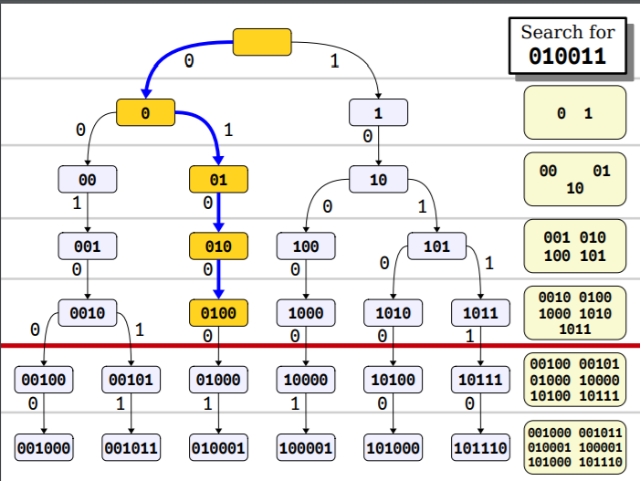
Reducing look-up time using hash table
Store prefix at each layer in a hash table.
Lookup time for preflix at each layer O(1).
Can binary search across layers for longest prefix.
Lookup time is O(log log M).

Slide 4
Let’s Look at an example
Insert 7
Level 0
root
Level 1
0
Level 2
01
Level 3
011
Level 4
0111

Slide 5
Let’s Look at an example
Insert 14 (1110)
Level 0
root
Level 1
0
1
Level 2
01
11
Level 3
011
111
Level 4
0111
1110

Slide 6
Let’s Look at an example
Insert 10 (1010)
Level 0
root
Level 1
0
1
Level 2
01
11
Level 3
011
111
Level 4
0111
1010
1110

Slide 7
Let’s Look at an example
Insert 10 (1010)
Level 0
root
Level 1
0
1
Level 2
01
10
11
Level 3
011
101
111
Level 4
0111
1010
1110

Slide 8
Let’s Look at an example
Insert 10 (1010)
Level 0
root
Level 1
0
1
Level 2
01
10
11
Level 3
011
101
111
Level 4
0111
1010
1110

Slide 9
Let’s Look at an example
Successor of 9 (1001)
Level 0
root
Level 1
0
1
Level 2
01
10
11
Level 3
100
011
101
111
Level 4
0111
1010
1110

Slide 10
Let’s Look at an example
Successor of 9 (1001)
Level 0
root
Level 1
0
1
Level 2
01
10
11
Level 3
100
011
101
111
Level 4
0111
1010
1110

Slide 11
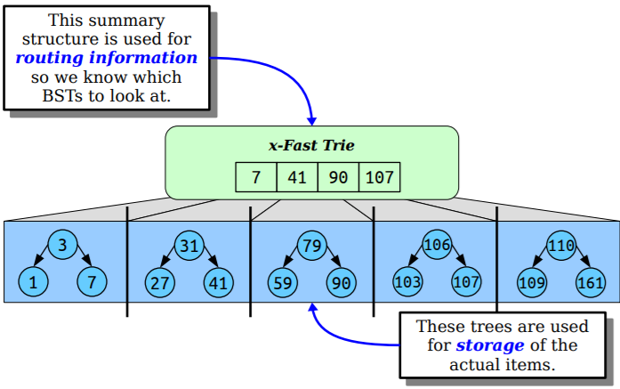
Y-fast Trie
Two level data structure.
Split data into chunks of size log(M).
Each chunk organized in BST.
Max value of each chunk stored in X-fast trie.

Slide 12
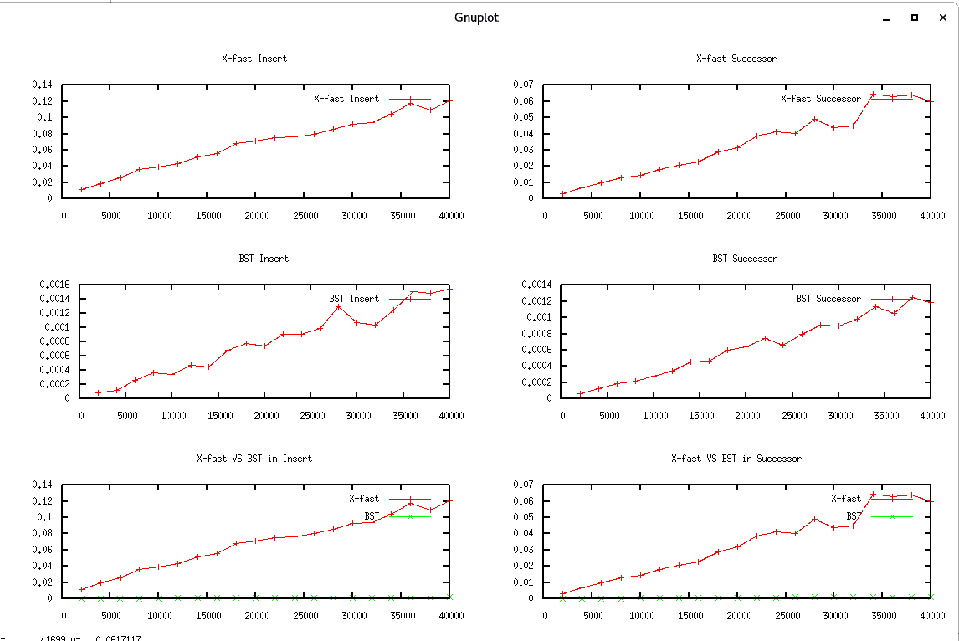

Slide 13
Complexity comparison
 | BST | X-fast Tries | Y-fast Tries
Space | O(N) | O(N lg M) | O(N)
Search | O(lg N) | O(lg lg M) | O(lg lg M)
Insert | O(lg N) | O(lg M) | O(lg lg M)
Delete | O(lg N) | O(lg M) | O(lg lg M)
Successor | O(lg N) | O(lg lg M) | O(lg lg M)

